Slide 1
Build An Employee Travel Approval Application For Corporates
Bharathi Women's College
Physics department
Team ID : NM2023TMID04313
Team Leader : POOJA P
Team member : MONISHA S
Team member : SWETHA R
Team member : VAISHNAVI M

Slide 2
INTRODUCTION:
Salesforce:
Salesforce is your customer success platform, designed to help you sell, service, market, analyze, and connect with your customers.
Salesforce has everything you need to run your business from anywhere.
Using standard products and features, you can manage relationships with prospects and customers, collaborate and engage with employees and partners, and store your data securely in the cloud.
So what does that really mean?
Well, before Salesforce, your contacts, emails, follow-up tasks, and prospective deals might have been organized something like this:
See More...

Slide 3
PROJECT DESCRIPTION:
The project aim is to provide real-time knowledge for all the students who have basic knowledge of Salesforce and Looking for a real-time project.
This project will also help to those professionals who are in cross-technology and wanted to switch to Salesforce with the help of this project they will gain knowledge and can include into their resume aswell.
1. Real Time Salesforce Project
2. Object & Relationship in Salesforce
What you'll learn

Slide 4
Empathy Map:-

Slide 5
Ideation and Brainstorming Map:-

Slide 6
Milestone 1- Create Salesforce Org:
Activity-1:
Creating Developer Account Creating a developer org in salesforce.
Go to developers.salesforce.com/
2. Click on sign up.
3. On the sign-up form.
Activity-2:
Account Activation Go to the inbox of the email that you used while signing up. Click on the verify account to activate your account. The email may take 5-10mins, as
Login To Your Salesforce Account
use this to login click this for your use
Click on sign up after filling these

Slide 7
Milestone 2 Creating the Application:
The App Manager is your go to place for managing apps for lightning experience.
https://www.youtube.com
Activity-1:
Create the Travel Application Search App Manager in quick find box, click on new lightning app. Before creating the application download this zip file and extract it.
Steps :
From Setup, enter App Manager in the Quick Find and select App Manager.
Click New Lightning App. Enter Travel Approval as the App Name, then click Next
Travelappworkshop.zip just click this above link
Under App Options, leave the default selections and click Next.
Under Utility Items, leave as is and click Next.
From Available Items, select Department, Travel Approval, Expense Item, Reports, and Dashboards and move them to Selected Items. Click Next.
To verify your changes, click the App Launcher, type Travel Approval and select the Travel Application app.
From Available Profiles, select System Administrator and move it to Selected Profiles.Click Save & Finish.

Slide 8
Milestone 3 -What is an object?:
In this Travel Approval application we will be creating 3 objects:
Department
Travel approval and
Expense Item
Activity-1 & Activity-2:
Custom Object Creation
After you Login to your org, click create on the right side of the page and select custom object.
Create Department Object
1.From Setup, click Object Manager. 2.Click Create, then select Custom Object.
3.Give the name as Department
To create an object:
From the setup page → Click on Object Manager → Click on Create → Click on Custom Object
To Navigate to Setup page:
Click on gear icon → click setup.
To create an object:
From the setup page → Click on Object Manager → Click on Create → Click on Custom Object.
On Custom object defining page:
Enter the label name, plural label name, click on Allow reports, Allow search → Save.
Now the tabs section opens
add this tab to the travel app
On Custom object defining page:
Enter the label name, plural label name, click on Allow reports, Allow search → Save
2. Create 3 custom objects and tabs
a) Department
b) Travel Approval
c) Expense Item

Slide 9
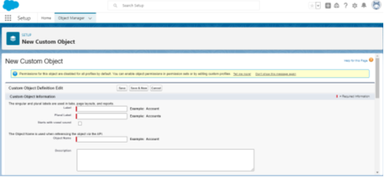
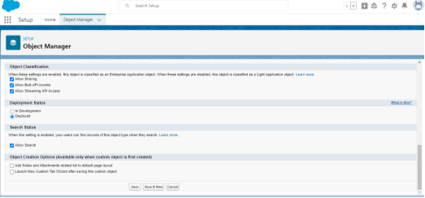
3. Create Travel Approval Object Navigate back to Object Manager Click Create then select Custom Object.
Enter these details
Parameter Value
Label TravelApproval
Plural Label TravelApprovals
Object Name Travel_Approval
(this field autopopulates)
Record Name Travel Approval #
Datatype Auto Number
DisplayFormat TA-{00000}
Starting Number 1
Allow Reports, search, and launch a new tab and add this tab to the travel app.

Slide 10
Milestone 4-What is a Tab?
Activity-1:
Now create a custom tab
Click the Home tab, enter Tabs in Quick Find and select Tabs.
Under Custom Object Tabs, click New.
For Object, select Event.
2. For Tab Style, select any icon.
3. Leave all defaults as it is, Click Next, Next, and Save
In the same way create other objects such as Attendees, Speaker and Vendor.

Slide 11
Milestone 4 Create- Fields& Relationships :
Activity-1:
1. Click Fields & Relationships, and click New.
Activit-2:
Create the Expense Type field.
2. For data type, select Currency. 3. Enter these details
• Select Picklist as the data type.
• Select Enter values, with each value separated by a new line.
• Add these values:(Airfare, Hotel, Rental Cars, Meals , Others)
• Select Required.
• Click Next, Next, then Save & New.
For Field Label, enter Amount
For Length, enter 16
For Decimal places, enter 2
Select Required
4. Click Next, Next, then Save & New.
Activit-3:
Create the Travel Approval field.
• Select Master-Detail Relationship data type, click Next.
• Select Travel Approval from the Related To menu.
• Click Next four times, then click Save.

Slide 12
Milestone 5-Import Departments
Activity-1:
download csv file just click here..
This takes you to the bulk import summary window that shows that the process has completed and 16 records have been successfully imported or processed. You’ll also get an email notification confirming the import.

Slide 13
Milestone 6-Customize User Interface
Activity-1:
Create User and Setup Approvals

Slide 14
Milestone 7- Use customization
Activity -1:
Customize Travel Approval Object Page layout

Slide 15
Milestone 8-Add Business Logic to Travel App
Activity-1:
Create Validation Rule
Activity-3:
Create Formula Fields
Activity-2:
Create RollUp Summary Fields

Slide 16
Milestone 10-What are Reports?
Activity
Add Report

Slide 17
Milestone 11- Dashboards:
Activity:
Create Travel Approvals Dashboard

Slide 18
Thank you

